Slide 1
EYE DONATION SENSITIZATION & PLEDGING
[Multi Organ Harvesting Aid Network]
www.mohanfoundation.org

Slide 2
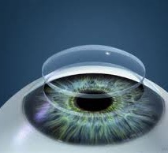
What is a Cornea?
CORNEA
Transparent & clear tissue in the central part of the eye
Light entering the eyes pass through the transparent corneas – Focusing element

Slide 3
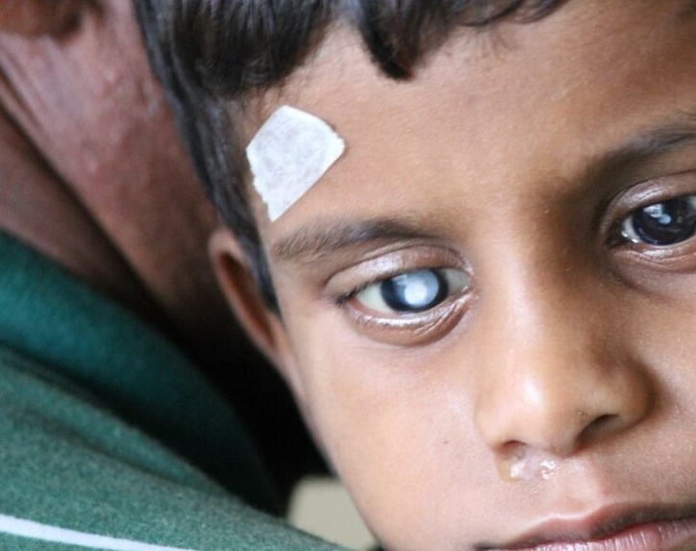
Corneal Blindness
When corneas become opaque or cloudy – causes Corneal Blindness

Slide 4
Causes
Corneal Injury from accidents
Sharp objects
Chemical burns
Flying debris
Accidents in children – while playing with sharp objects
Corneal Infections
Malnutrition – Vitamin A Deficiency in children
Hereditary

Slide 5
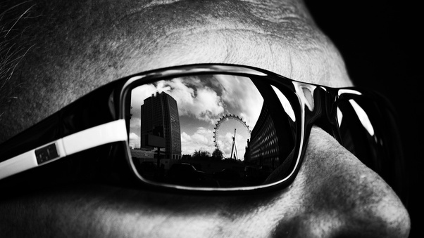
The Problem: 11,00,000 Corneally blind people in India
The Need: 1,00,000 corneal transplants every year
The Availability: 25,000 Corneal Transplants
The Potential: India saw 1.2 crore deaths in 2022

Slide 6
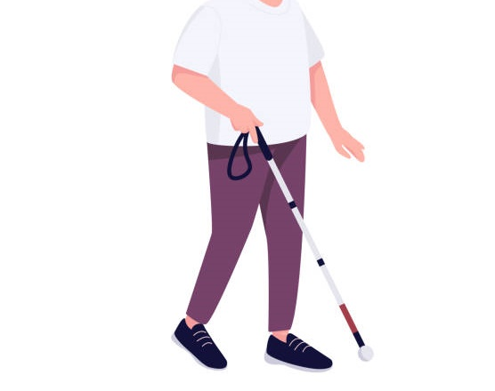
Corneal Blindness – Highest in Young India
Survey:
National Blindness & Visual Impairment Survey India, 2019
By AIIMS Delhi and Ministry of Health & Family Welfare
In population aged <50 years
Corneal Blindness – 37.5%
In population > 50 years
Cataract – 66.2%
Corneal Blindness – 8.2%

Slide 7
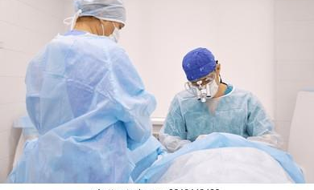
How is Corneal Blindness cured?
Damaged corneas - surgically replaced with healthy ones donated by a donor
Success rate of 95%+
No artificial alternative developed so far

Slide 8
Who can be a donor?
Who cannot donate?
Anyone upto 80 years of age**
Irrespective of medical conditions such as BP, Diabetes, Asthma
Irrespective of blood group, sex and religion
Irrespective of cataract or wearing Spectacles
Persons suffering from -
Active cancer
Sepsis / Septicemia
Infections
Rabies
** Age limit applicable in Maharashtra; No age limit in most other states

Slide 9
Eye donation process
MOHAN Foundation
Eye donation Helpline 9444607000
Eyes are donated posthumously only.
At Home or Hospital.
Family member to call MF Helpline or nearest eye bank at the earliest - within 1 – 2 hours of death.
Family to arrange Death Certificate or provisional from treating doctor / hospital.
Eye bank team arrives and obtains consent from next of kin.
Eyes must be retrieved within 6 hours of death and blood sample is also taken.
Retrieval is completed in 15-20 minutes

Slide 10
Precautions
Close eye-lids & Place wet cotton balls to keep it moist
Switch OFF fan, Switch ON AC if available
Prop head slightly with a pillow
Call MF Helpline or nearest eye bank
Eye donation to be done within 6 hours of death

Slide 11
Giving others a Brighter Tomorrow
Corneas restore vision in 2 persons
Eyes are use in Research and Education:
Research
Led to advancements in glaucoma, retinal disease, diabetic eye disease, other sight disorders
Enables newer treatments and cures
Education
For Eye doctors and Surgeons

Slide 12
Eye donation governed by Law - Transplantation of Human Organs and Tissues Act, 1994
No disfigurement after eye donation
Family can continue with funeral arrangements
All religions support Eye donation

Slide 13
What can you do?
Pledge Your Eyes
Discuss your wish with your family
Volunteer for the cause
Inspire others
Pass on the ‘Gift of Sight’

Slide 14
You give but little when you give of your possessions. It is when you give of yourself that you truly give
- Khalil Gibran

